Slide 1
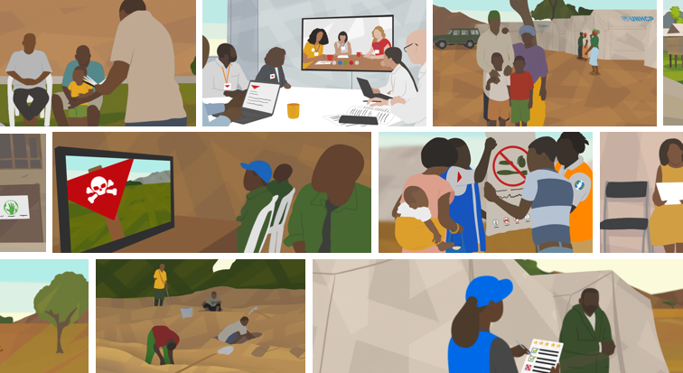
RISK EDUCATION

Slide 2
The story of the hummingbird
Copyright: UN Water

Slide 3
114 million
# of people displaced by war end 2023
84%
% of humanitarian operations where explosive ordnance represent a threat to people
Source: UNHCR
Source: Global Protection Cluster

Slide 4
Blocks access to aid, healthcare, education etc.
85% of all casualties = civilians
Half of which were children
4,710
Casualties in 2022
Source: Landmine Monitor 2023

Slide 5
5 COMPONENTS OF MINE ACTION
Clearance
Risk Education
Victim Assistance
Advocacy
Stockpile Destruction
https://www.mineactionstandards.org/

Slide 6
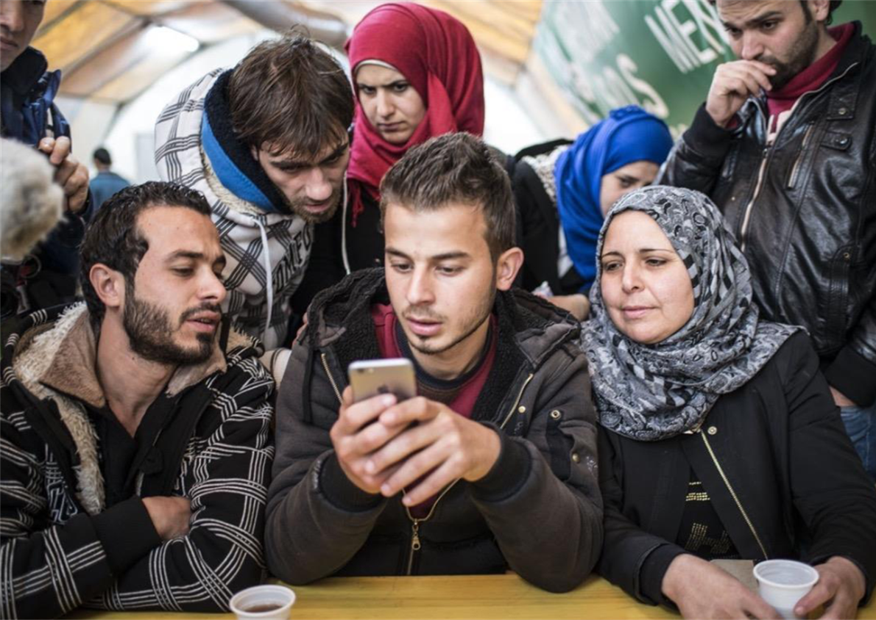
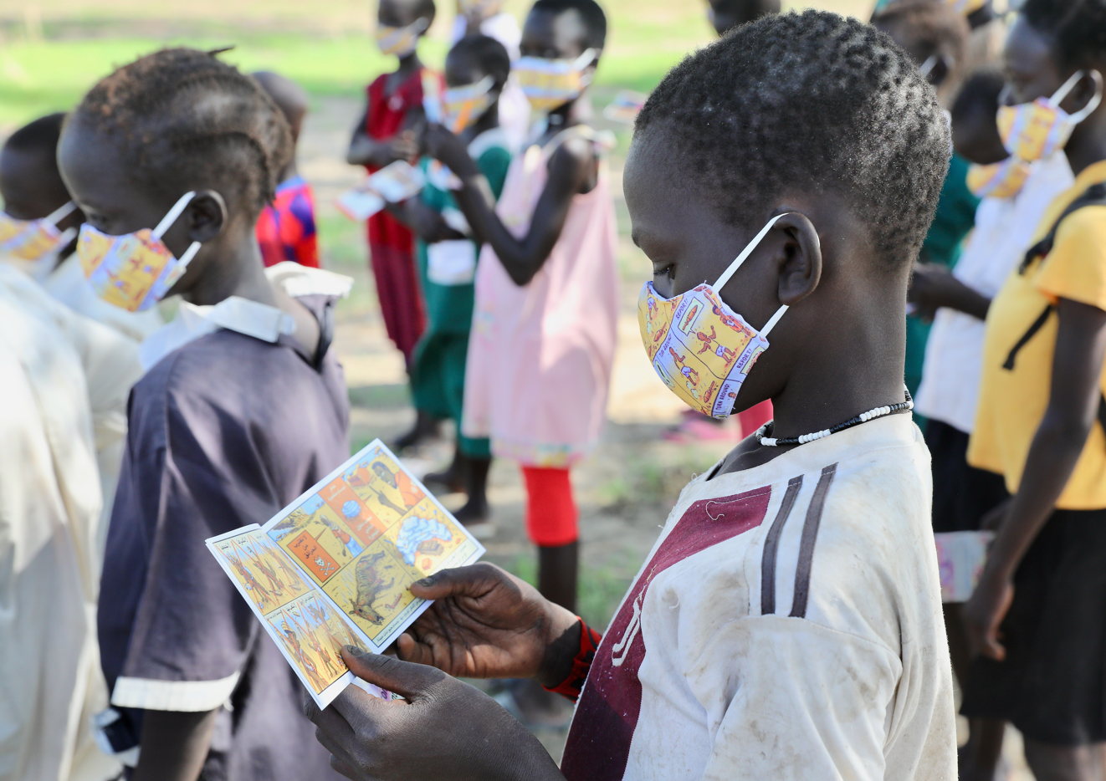
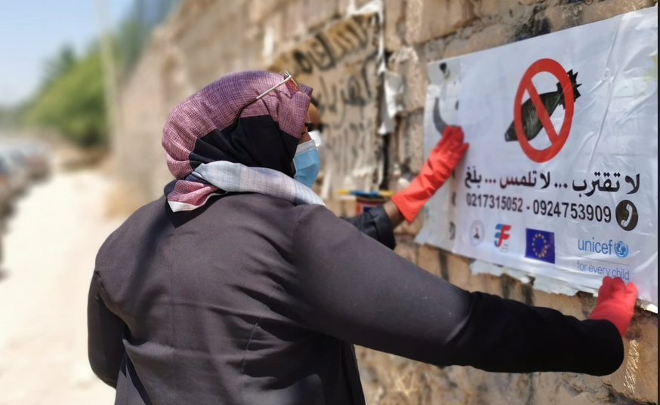
WHAT IS EXPLOSIVE ORDNANCE RISK EDUCATION?
Activities to raise awareness & promoting behavioral change in relations to explosive ordnance (landmines, cluster munitions, and remnants of war)
No ‘one size fits all approach’

Slide 7
Why does RISK EDUCATION matter?
Primary means of preventing new accidents
Life-saving in emergencies and until clearance is possible
An obligation for States Parties to the Convention on Cluster Munitions and other Treaties

Slide 8
WHO DELIVERS RISK EDUCATION?
Local grassroots actors
i.e., Red Cross and Red Crescent National Societies
Community focal points
National and international non-governmental organisations
Support from donors and governments

Slide 9
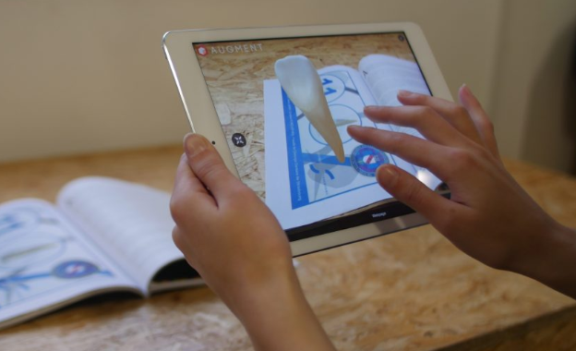
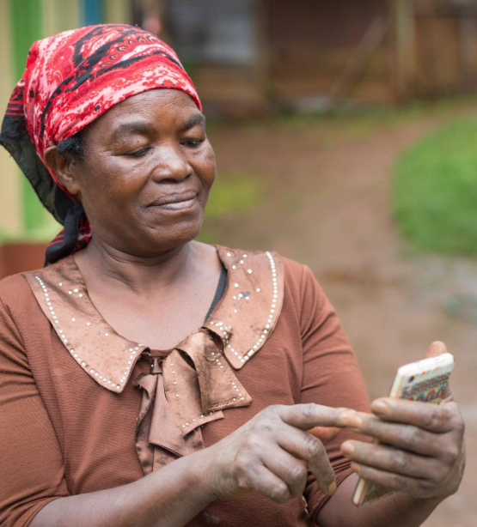
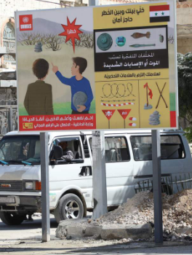
WHAT DOES RISK EDUCATION LOOK LIKE?
Social media
Apps
TV
Virtual & Augmented Reality
E-learnings
Loudspeakers
Leaflets
Posters
Billboards
Radio
SMS campaigns
Pre-recorded messages

Slide 10
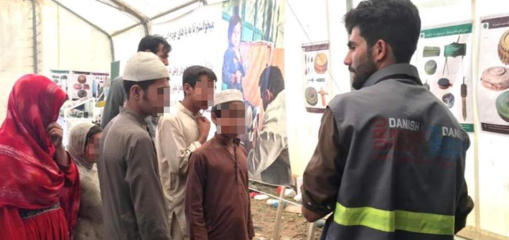
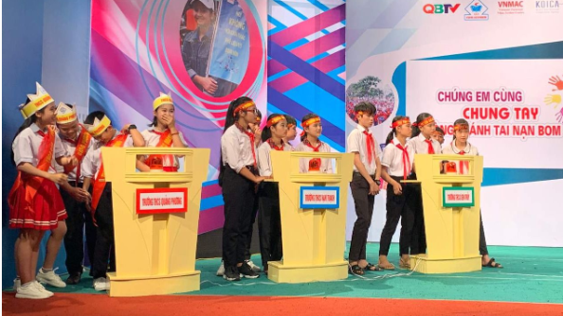
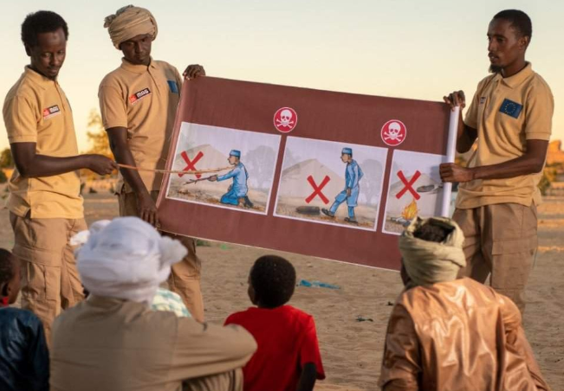
WHAT DOES RISK EDUCATION LOOK LIKE?
Public sessions
Road shows
Puppet shows
Cross-border sessions
Edutainment & games
Education curriculum
Emergency risk education
Notes:
….

Slide 11
GET STARTED
Duration: 60 min.
Languages: Arabic, English, French and Ukrainian
Audience: This introductory e-learning course is for anyone interested in learning about the key principles risk education
Accessible on: https://training.gichd.org/

Slide 12
Be the change you want to see in the world
Join the Youth Multimedia Contest!

Slide 13
THANK YOU m.laruelle@gichd.org

